Slide 1


DATA MINING LABORATORY - 20MSSL04
HEART DISEASE
PREDICTION
TEAM NO: 16
MEMBERS:
71762131041 - SAI NIKHIL.S
71762131047 - SHANTHOSH BABU.R

Slide 2
1
2
3
4
5
Introduction
Attributes
Algorithm’s
Input’s
Conclusion
AGENDA

Slide 3
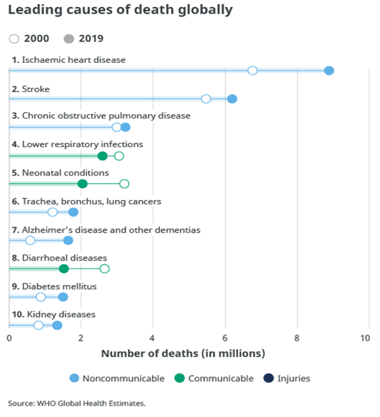
INTRODUCTION
One of the major and common issue in the world that causes diseases is the heart diseases according to the WHO [World Health Organization] the top reason is the heart issues that affect the people all around.
A Deep Into the Cause
OBJECTIVES :
The main objective of developing this project are:
1. To develop machine learning model to predict future possibility of heart disease by implementing Logistic Regression, Decision Tree .
2. To determine significant risk factors based on medical dataset which may lead to heart disease.
3. To analyze feature selection methods and understand their working principle.
KEYWORDS:
Data mining, classification, Neural Networks, Parallelism, Heart Disease

Slide 4
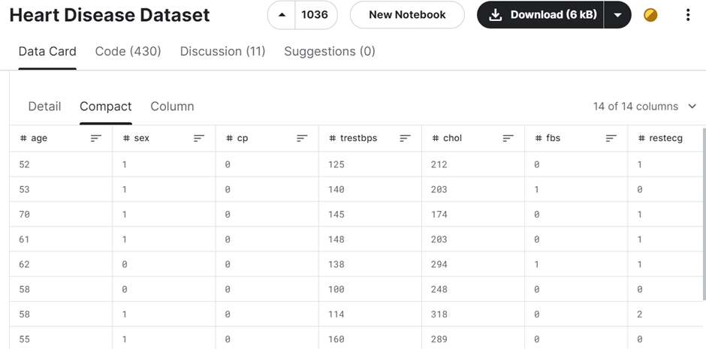
DATASET
https://www.kaggle.com/datasets/johnsmith88/heart-disease-dataset

Slide 5
The attributes include age, sex, chest pain type, resting blood pressure, serum cholesterol, fasting blood sugar, resting electrocardiographic results, maximum heart rate, exercise-induced angina, ST depression induced by exercise, slope of the peak exercise ST segment, number of major vessels colored by fluoroscopy, thalassemia status, and the target variable.
Target:
0 - Not affected
1 - Affected

Slide 6


PROCESS
Development Phase
2
Select Atrributes
4
Algorithm Selection
1
Data Cleaning
3
Target & Train Dataset
5
Prediction

Slide 7
1.Logistic Regression
2.Decision Tree
ALGORITHM’S
The main purpose of this is to design a system to predict the risk of the heart disease at the earlier stage
Logistic Regression and Decision Trees. Each algorithm has its own approach to model training and prediction.
These algorithms are discussed below in detail.

Slide 8
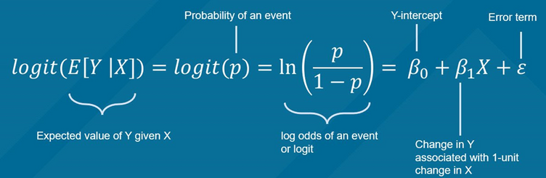
LOGISTIC
REGRESSION
Logistic Regression is a statistical method for analyzing datasets in which there are one or more independent variables that determine an outcome. The outcome is measured with a dichotomous variable (in which there are only two possible outcomes). In this case, the target variable indicates the presence (1) or absence (0) of heart disease.
• | P is the probability of the presence of heart disease.
• | 𝛽0β0 is the intercept term.
• | 𝛽1,𝛽2,…,𝛽𝑛β1,β2,…,βn are the coefficients for the predictor variables 𝑋1,𝑋2,…,𝑋𝑛X1,X2,…,Xn.

Slide 9
DECISION
TREE
Decision Trees are non-parametric supervised learning methods used for classification and regression. The goal is to create a model that predicts the value of a target variable by learning simple decision rules inferred from the data features. Decision trees partition the data into subsets based on the value of the input features. This is done recursively, and the process is represented as a tree structure.
Select the Best Feature
split the data
stopping criteria
Gini Impurity is a common criterion used for splitting nodes in decision trees:
Gini(𝑡)=1−∑𝑖=1𝐶𝑝𝑖2Gini(t)=1−∑i=1Cpi2
where:
• 𝑡t is a node.
• 𝐶C is the number of classes.
• 𝑝𝑖pi is the proportion of samples belonging to class 𝑖i at node 𝑡t.

Slide 10





EVALUATION METRICS
ACCURACY:
PRECISION:
80%
85%
0.81
0.86
RECALL:
F1-SCORE:
0.79
0.84
0.80
0.85

Slide 11
DISCUSSION ON RESULT
From the Patient's Perspective:
For patients, accurate prediction of heart disease is crucial for early detection and intervention. The high accuracy and balanced precision and recall scores of both logistic regression and decision tree models provide reassurance to patients that the models can effectively identify the presence or absence of heart disease based on their medical attributes. This empowers patients to take proactive steps towards managing their cardiovascular health and seeking timely medical assistance if necessary.

Slide 12
DISCUSSION ON RESULT
From the Doctor's Perspective:
For doctors and healthcare professionals, reliable predictive models are valuable tools for risk assessment and clinical decision-making. The results indicate that both logistic regression and decision tree models perform well in predicting heart disease, with the decision tree model exhibiting slightly higher accuracy. Doctors can leverage these models to enhance diagnostic accuracy, prioritize patient care, and tailor treatment plans based on individual risk profiles. Furthermore, the interpretability of decision tree models allows doctors to gain insights into the key factors influencing the likelihood of heart disease, facilitating more informed discussions with patients about their health status and potential interventions.

Slide 13
DISCUSSION ON RESULT
From the Common Man's Perspective:
For the general public, the availability of accurate predictive models for heart disease serves as a means of raising awareness about cardiovascular health and promoting preventive measures. Understanding the role of various risk factors such as age, cholesterol levels, and exercise-induced angina can encourage individuals to adopt healthier lifestyle habits and undergo regular health screenings. By leveraging data mining techniques to analyze large datasets and develop predictive models, researchers and healthcare professionals can contribute to public health initiatives aimed at reducing the burden of heart disease in communities.

Slide 14
DISCUSSION ON RESULT
Relating to Data Mining Techniques:
The success of the heart disease prediction project highlights the effectiveness of data mining techniques in extracting meaningful insights from complex healthcare datasets. Data preprocessing techniques such as cleaning and scaling ensure that the data is suitable for model training, while feature selection methods help identify the most relevant attributes for predicting heart disease. Machine learning algorithms such as logistic regression and decision trees leverage these techniques to build predictive models that can accurately classify patients based on their medical attributes. By harnessing the power of data mining, stakeholders can harness the potential of data-driven approaches to improve patient outcomes and advance cardiovascular health research.

Slide 15
Conclusion:
Utilizing logistic regression, the project achieved a commendable accuracy of 85% in predicting heart disease. Moving forward, there is potential for further enhancements by training on more advanced models and expanding the scope to predict specific types of cardiovascular diseases.

Slide 16
THANK
YOU

